Slide 1
Making a Key

Slide 2
First A Review!!!

Slide 3
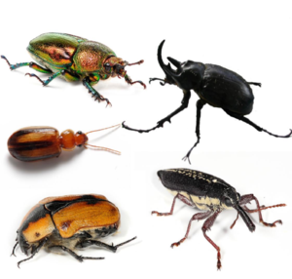
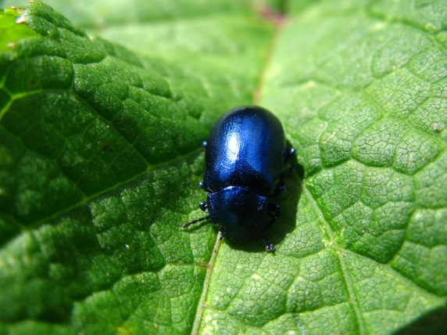
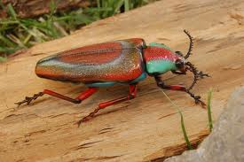
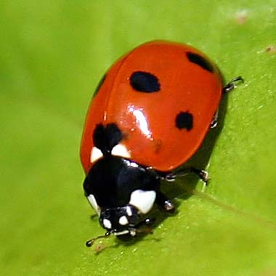
Coleoptera – ???

Slide 4

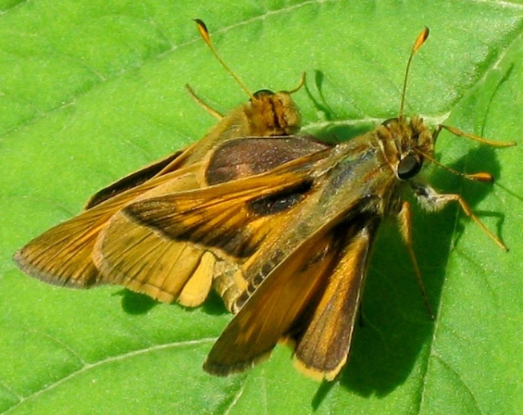
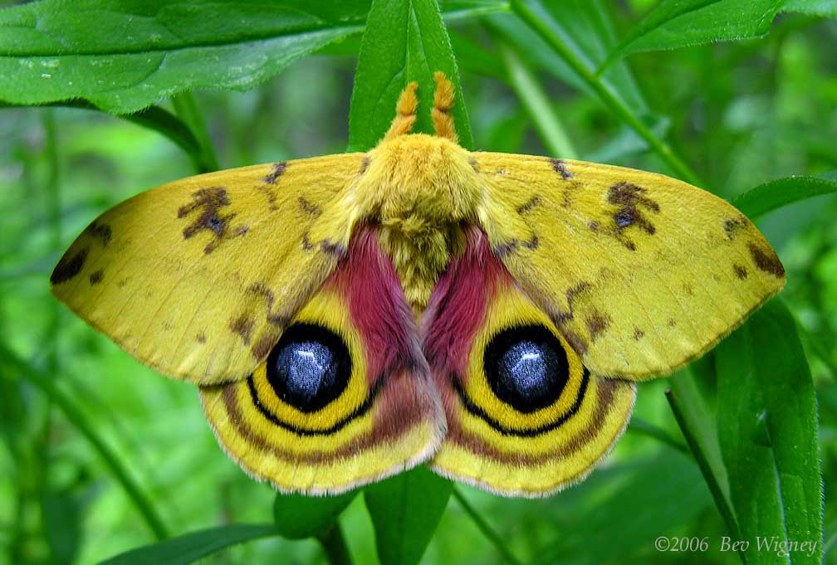
Lepidoptera – ???

Slide 5
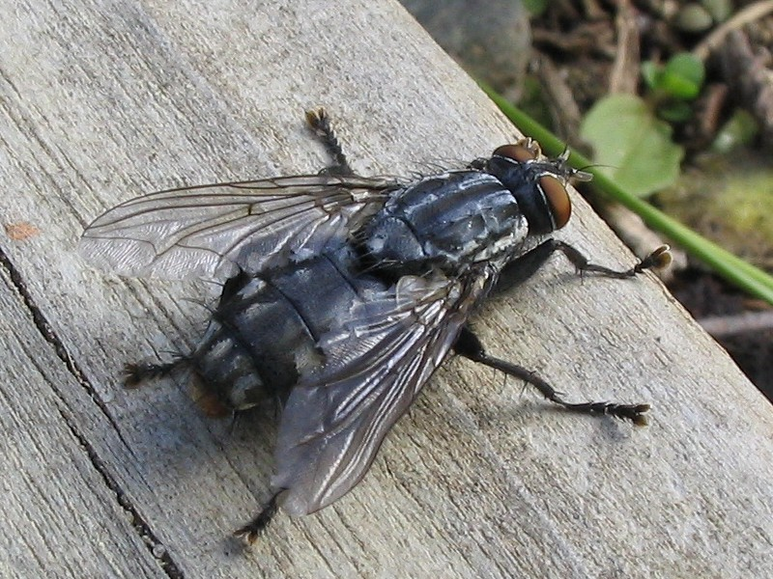
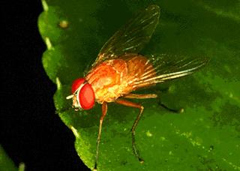
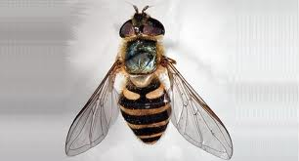
Diptera - ???

Slide 6
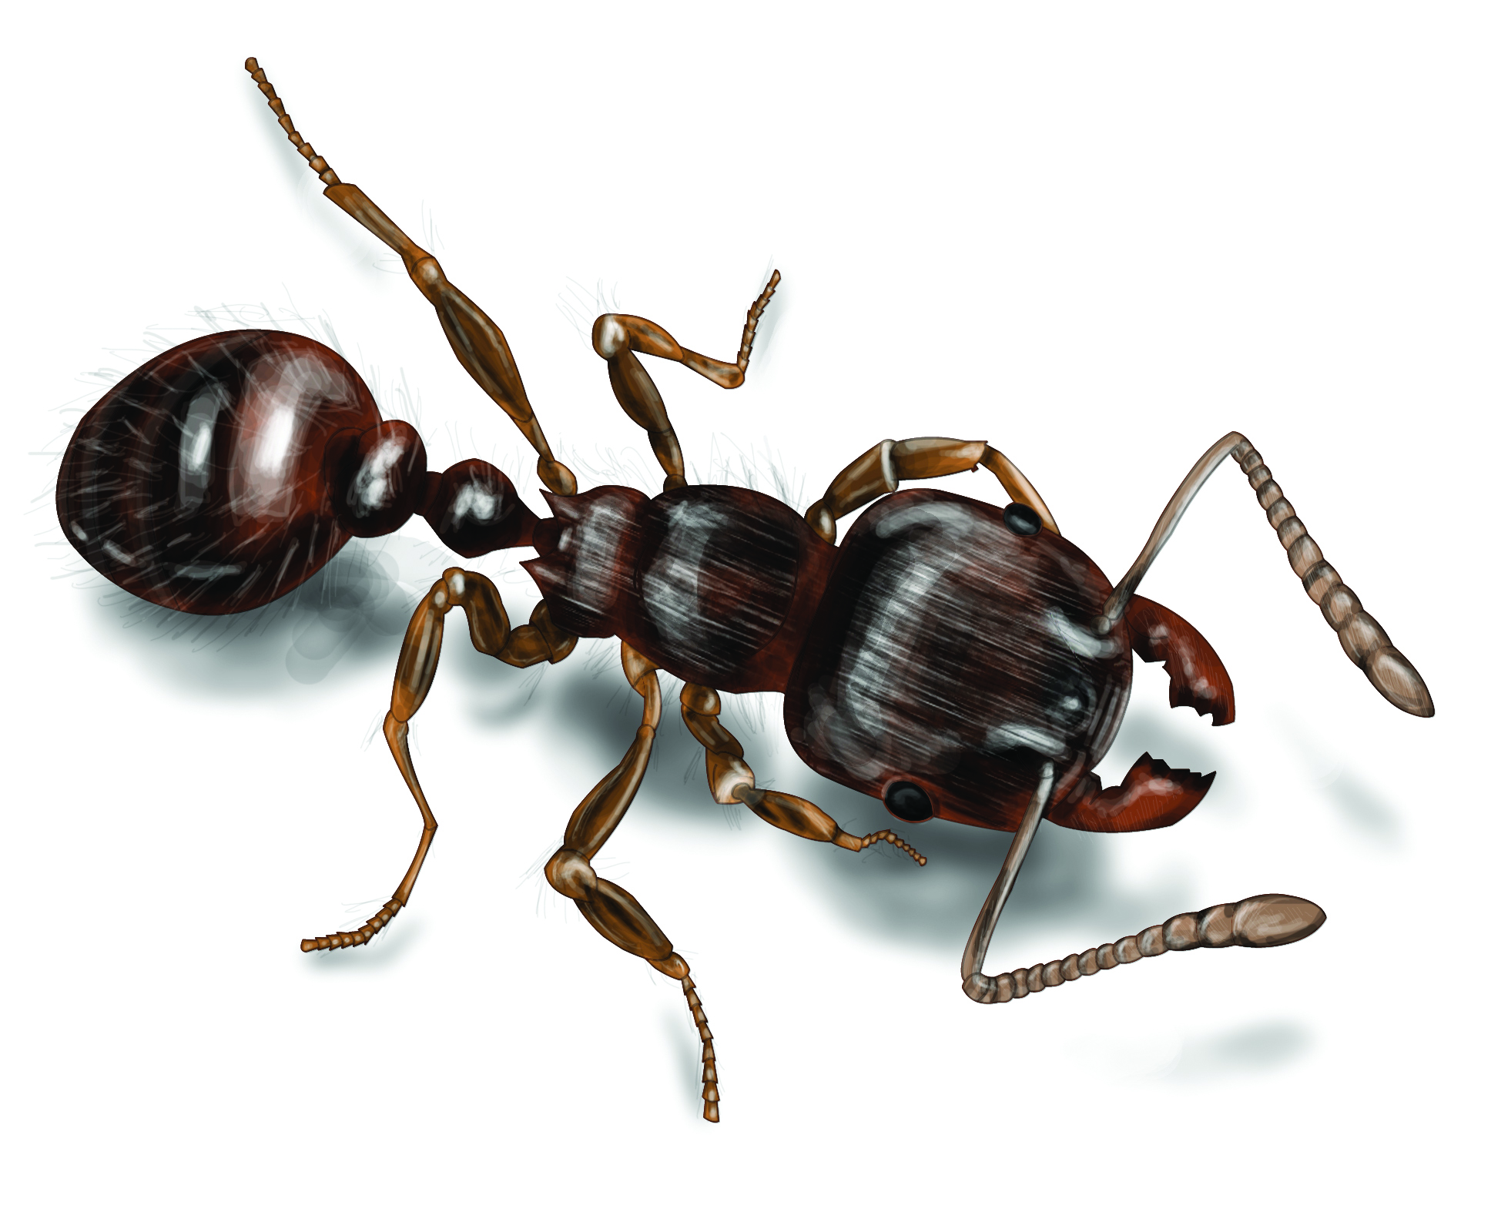
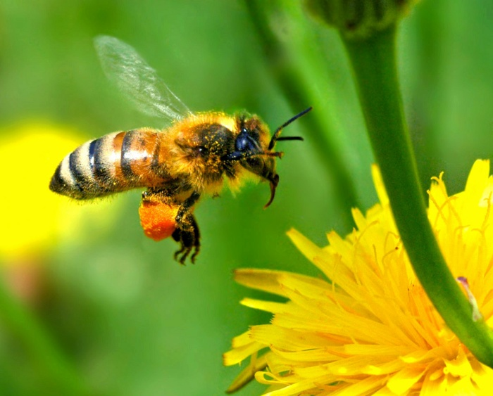
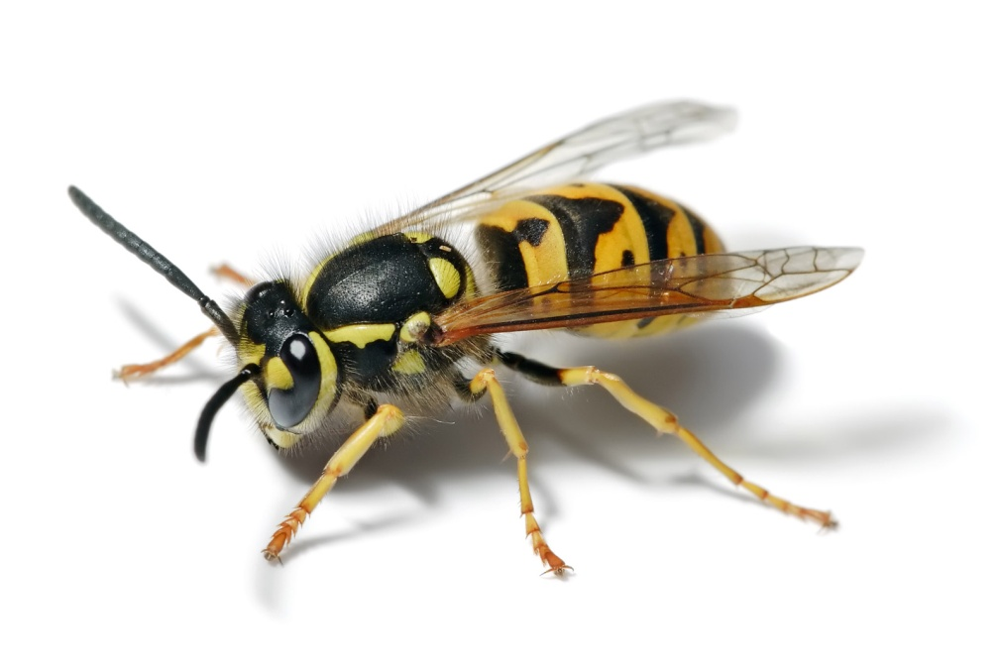
Hymenoptera – ???

Slide 7
Classification
Grouping and naming of species
Combine groups based morphological similarities
Review:
What are the different groups of classification?

Slide 8
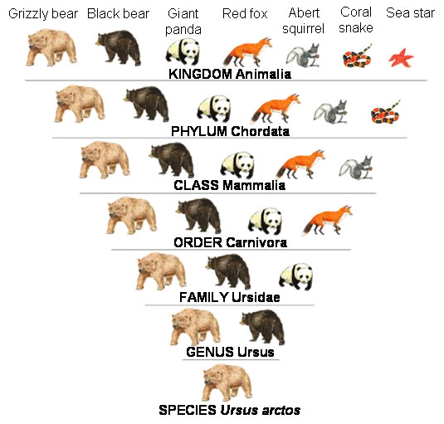
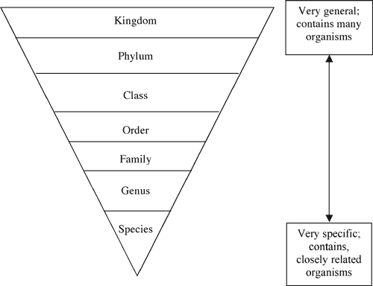
Taxonomy – Classification

Slide 9
Dichotomous key
A dichotomous key is a tool that scientists can use to help identify a particular specimen.
In science we use many helping aids to organize and easily retrieve information.
The specimen could be a chemical that is identified by its physical properties, an insect identified by its markings and traits, or even a rock sample based on its different properties. The term dichotomous begins with the prefix of "di" which means two.
The dichotomous key allows for the scientist to ask a series of questions with yes or no answers. Each question should be phrased so that the answer will either be yes or no.

Slide 10
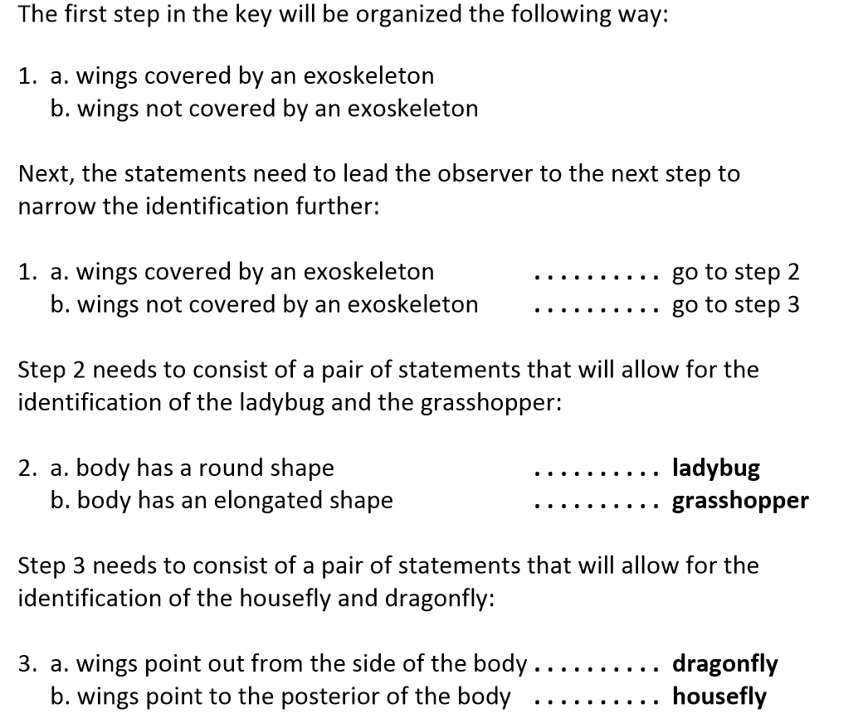
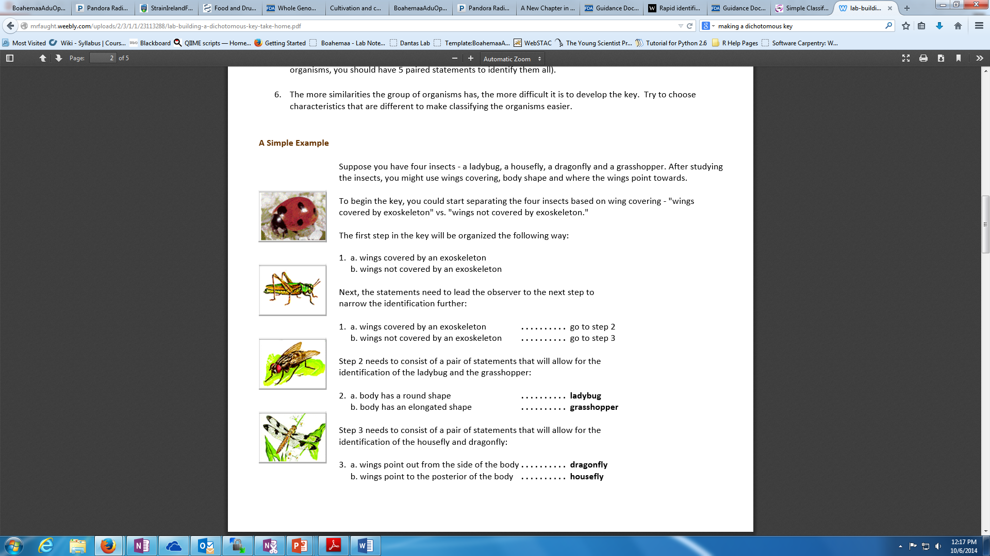
Example

Slide 11
Create a Dichotomous Key
Look at the Hand out of 10 organisms and try to create a key

Slide 12
Look at the Handout for insects:

